Slide 1
Fingere di avere uno stagista grazie a Azure Copilot e Security Copilot
Francesco Valerio Buccoli
fbuccoli@microsoft.com
Senior una volta ero un sistemista oggi faccio Excel

Slide 2
Copilot for Azure
Would like to go from previous 5 slides slides to some illustration of the LLM architecture
Want to make it clear what we are using for the data sources with the LLM
Then, like slide 37 (immediate predecessor), would like to show that all arc connected stuff can be reasoned over as well.
We’ll need to add a visual representation for Az Portal and Mobile
Tooling
API
SDK
CLI
PowerShell
Playing with a different header color here (not so blue on blue on blue). May apply to other slides if it works?
Data sources
Cost
Documentation
Logging
Monitoring
Governance
Policy
RBAC
Tags
Diagram of this, and then build to show building an LLM on top of this to operate on your Azure services
Azure Resource Model & Graph
Services
Infrastructure
Tooling – API, SDK, CLI, Powershell, Portal, Mobile App
Documentation
Data sources
Cost
Logging
Monitoring
Resource Graph
Resource Model
Policy
RBAC
Resources
Services
Infrastructure
Arc and Edge
Copilot LLM
Notes:
Let’s talk a little bit about how this is put together
First, let’s look at the logical layers that we build the portal and other tooling on top of
And, let’s think about there being a lot of knowledge in each of these that we’ll build on top

Slide 3
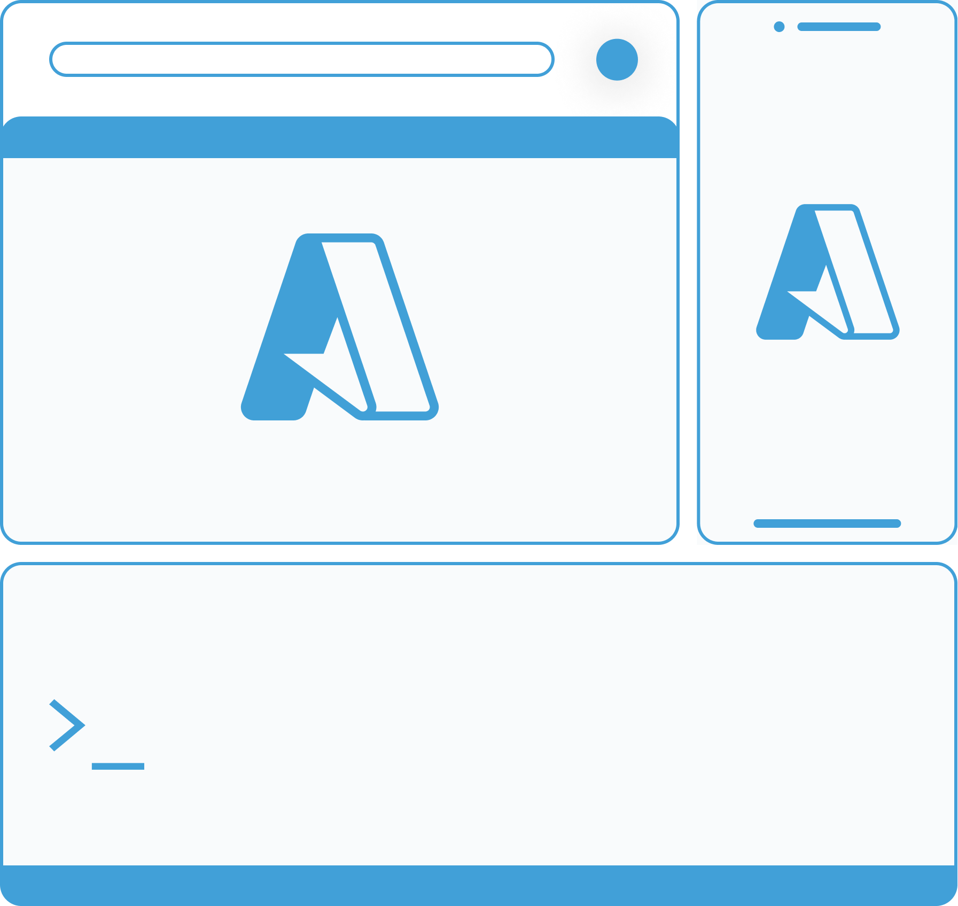
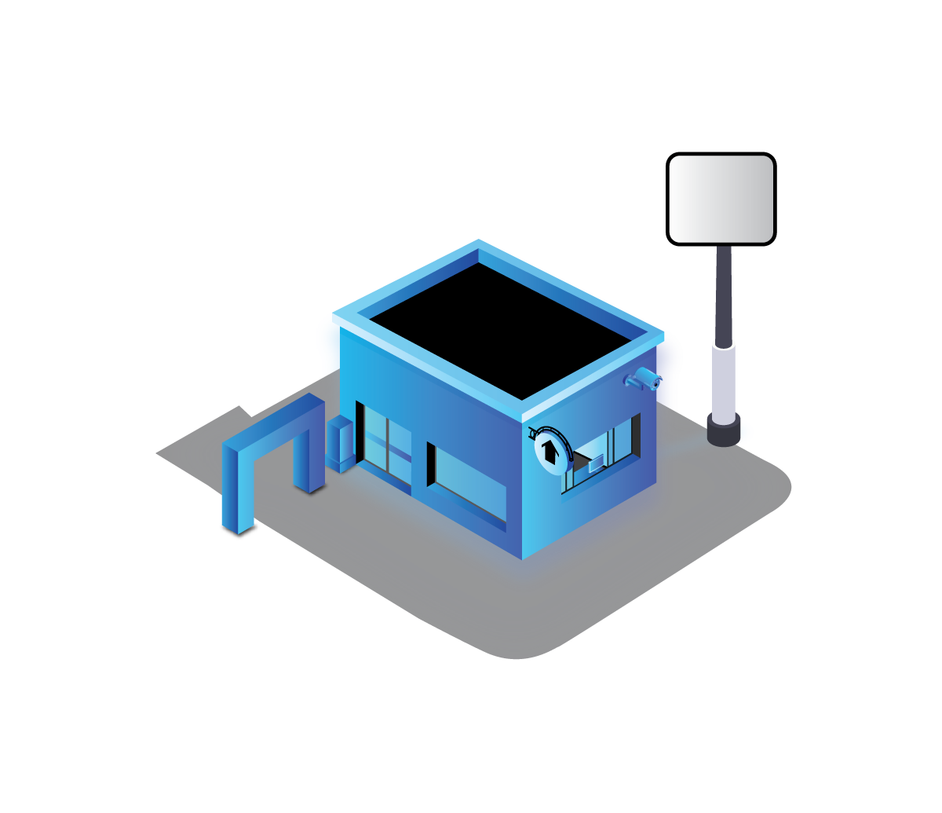
Copilot for Azure
Would like to go from previous 5 slides slides to some illustration of the LLM architecture
Want to make it clear what we are using for the data sources with the LLM
Then, like slide 37 (immediate predecessor), would like to show that all arc connected stuff can be reasoned over as well.
We’ll need to add a visual representation for Az Portal and Mobile
Arc and Edge
Tooling
API
SDK
CLI
PowerShell
Copilot LLM
Playing with a different header color here (not so blue on blue on blue). May apply to other slides if it works?
Data sources
Cost
Documentation
Logging
Monitoring
Governance
Policy
RBAC
Tags
Diagram of this, and then build to show building an LLM on top of this to operate on your Azure services
Azure Resource Model & Graph
Services
Infrastructure

Slide 4
Security Copilot (Microsoft Copilot for Security)
Microsoft
Defender
Microsoft
Purview
Cloud
platforms
Device
OSs
Microsoft Security Copilot
Microsoft
Sentinel
Microsoft
Priva
Microsoft
Entra
Microsoft
Intune
Microsoft Security Experts

Slide 5
Grazie

